Slide 1

Second Order Min Consensus on Switching Topology
20
24
20
24

Slide 2
Table of contents
01
Purpose statement
04
Protocol
02
Hypothesis
05
Analysis
03
Preliminaries
06
Conclusions
Objectives
Application
Control Protocol described
Abstract
Mathematical proof of convergence
Notation used
Simulation Results and Future Work

Slide 3
01
Purpose statement
20
24
Consensus
20
24

Slide 4

20
24
Achieving consensus : Fundamental issue in distributed cooperative control in multi-agent
systems and distributed computing
Past work include
Estimation of maximum value in wireless sensor networks
Max-consensus for first order systems with linear dynamics
Second order linear multi-agent systems with directed communication topology
NO existing min-consensus protocol for double-integrator multi-agent systems
20
24
Notes:
Consensus is the notion that all of the nodes (or participants) agree on a state variable’s value. Depending on the common value they reach consensus, some special cases include max-consensus, min-consensus and average consensus

Slide 5
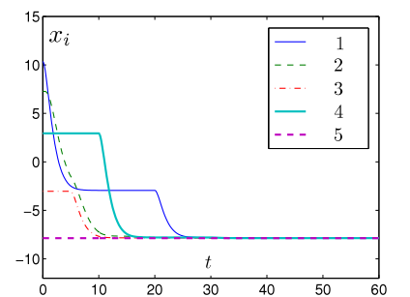

Applications
Mobile robots and unmanned aerial vehicles dynamics
Minimum altitude alignment problem in multiple UAVs
Difficult to extend first order case to second order
Proposed Protocol guarantees global asymptotic min-consensus under mild conditions
Notes:
It is difficult to extend the problem due to the inherent nonlinearity of the problem and the problem is further exacerbated by different topologies of the communication graphs

Slide 6
Hypothesis
20
24
02
Problem Description
20
24

Slide 7
Abstract
Second Order
Min Consensus
On
Switching Topology
First second-order minimum consensus protocol with provable convergence

Slide 8
03
Preliminaries
20
24
20
24

Slide 9
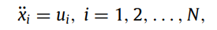
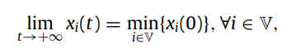
Problem Formulation
Consider a group of agents whose communication topology is described by an undirected graph.
Interested in the min-consensus problem of such an N-agent system with identical second order dynamics as follows:
Design: To design a fully distributed protocol such that the agents achieves asymptotic min-consensus
where,
Notes:
In practical applications, the failure of communication between two agents in a multi-agent system may happen due to various reasons, such as the existence of obstacle, long distance between the agents making them out of communication region which may later on be re-established. Results presented under jointly connected graphs

Slide 10
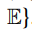
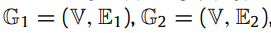
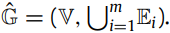
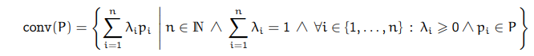
20
24
Notation
Undirected graph with vertex set and edge set, the value at each node given by x_{i} and the edge between node i and node j denoted by (i; j)
The set of neighbours of node i
Given where m is a finite integer, with the same node set is denoted by The collection of these graphs is said to be jointly connected if the union graph is connected.
Gradient of finite pointwise maximum/minimum function
is the set of all active functions
Convex Hull
20
24

Slide 11
04
Protocol
20
24
20
24

Slide 12
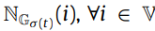
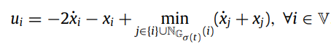
The communication graph is denoted by where
The set of neighbours of node i in this arrangement is given by
The control protocol for the jointly connected graph is described as
Remark : The protocol is fully distributed since it depends only on the neighbour set of each node at any point of time. In other words, the control action of any agent depends on its own state and the states of its neighbour agents.

Slide 13
05
Analysis

Slide 14
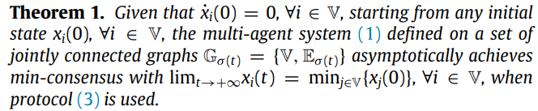
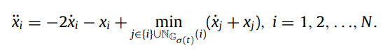
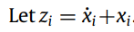
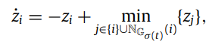
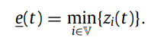
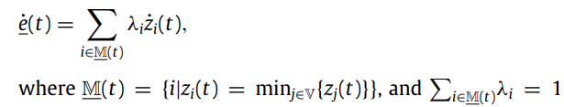
Key Theorem :
Step 1 : Substituting the control law
Step 2:
Step 3:
Step 4: Checking how the minimum function varies
Step 5:
Step 6:

Slide 15
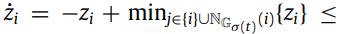
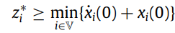
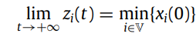
Step 7 : It follows that e(t) is a constant function implying that starting from an initial value, the minimum over all agents remains invariant with time.
Step 8 :
Step 9 : Thus, z_{i} is lower bounded and monotonically non-increasing, implying the limit exists.
Step 10 : for all nodes proving the existence of a steady state value or an equilibrium
Step 11 : We’ll prove consensus via contradiction. Suppose there are two neighbour nodes given by s₁ and s₂
, then at steady state, which means that the value of s_{i} will still decrease which is a contradiction to the equilibrium state. Similarly for the other case.
Step 12 : The above step guarantees that z_{i}* for all nodes takes the minimum value. With zero velocity, this implies

Slide 16
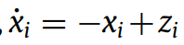
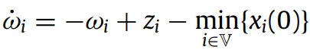
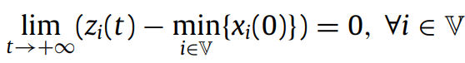
Step 13 : Consider and let
Step 14 : This results in which can be viewed as an exponentially stable linear time invariant system
Step 15 : Since we have proved that , at equilibrium state for ⍵_{i} , we get
Step 16 : Hence, we can see that since we have derived the result for any set of initial states, the system is globally asymptotically stable with this protocol
-------------------------------------------------
Remarks : We have used that the fact the initial velocities of all agents are 0, i.e all agents are static. Without this condition, the agreement value is also related to the initial speeds of all the agents.
Notes:
Intuitively, this condition guarantees that the changes in the state values of all the agents are a result of the values of the initial states and their local interactions.
Application to our problem : When they need to carry out the min-consensus with respect to the altitude, the initial altitude speed is zero

Slide 17
06
Simulations

Slide 18
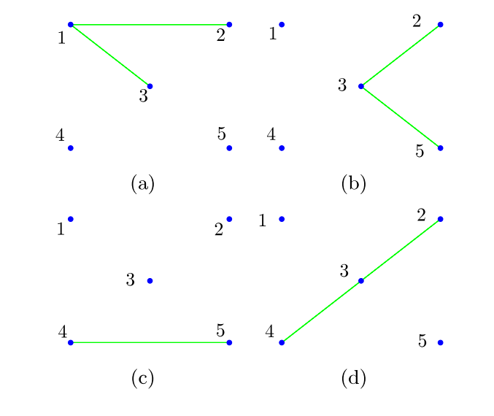
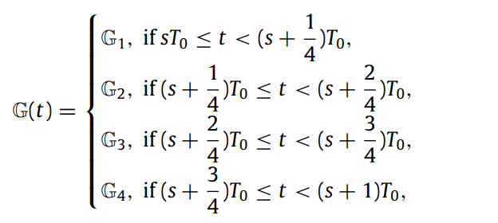
Communication graph with the switching function
Component Graphs

Slide 19
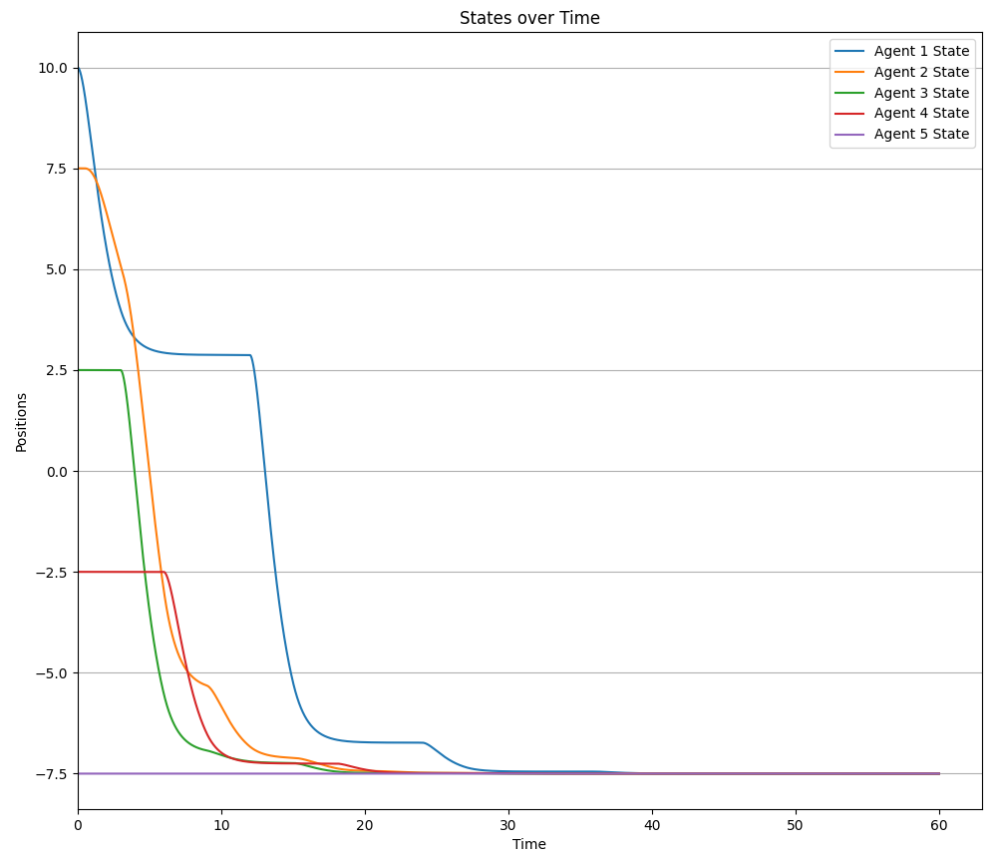

Slide 20
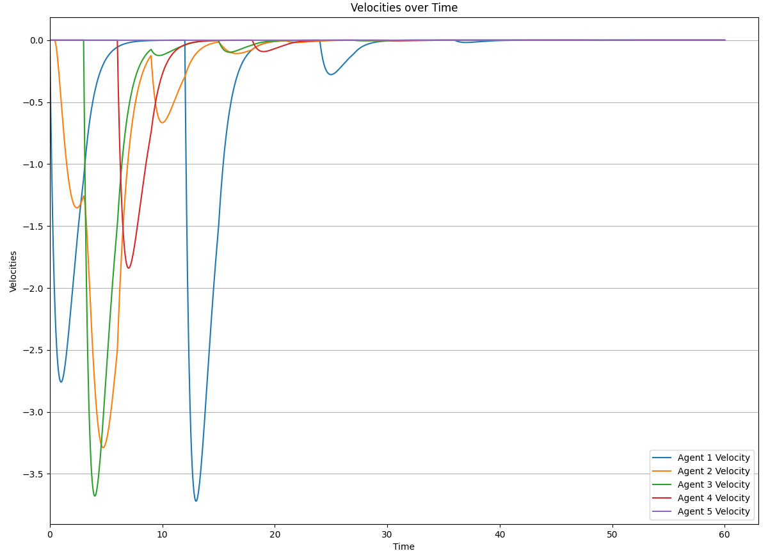

Slide 21
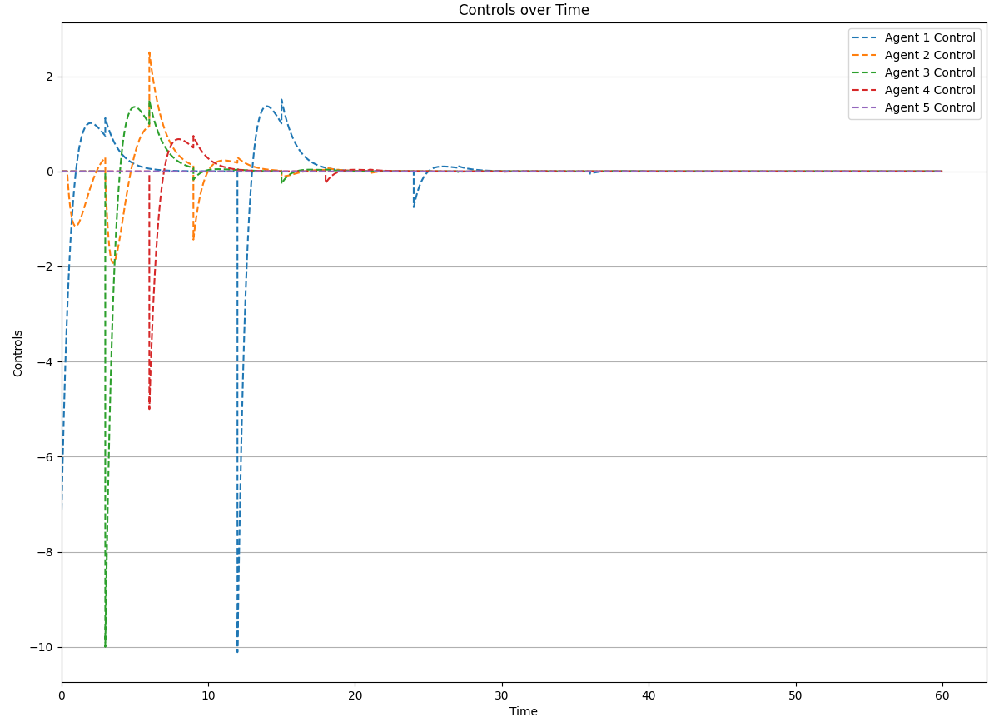

Slide 22
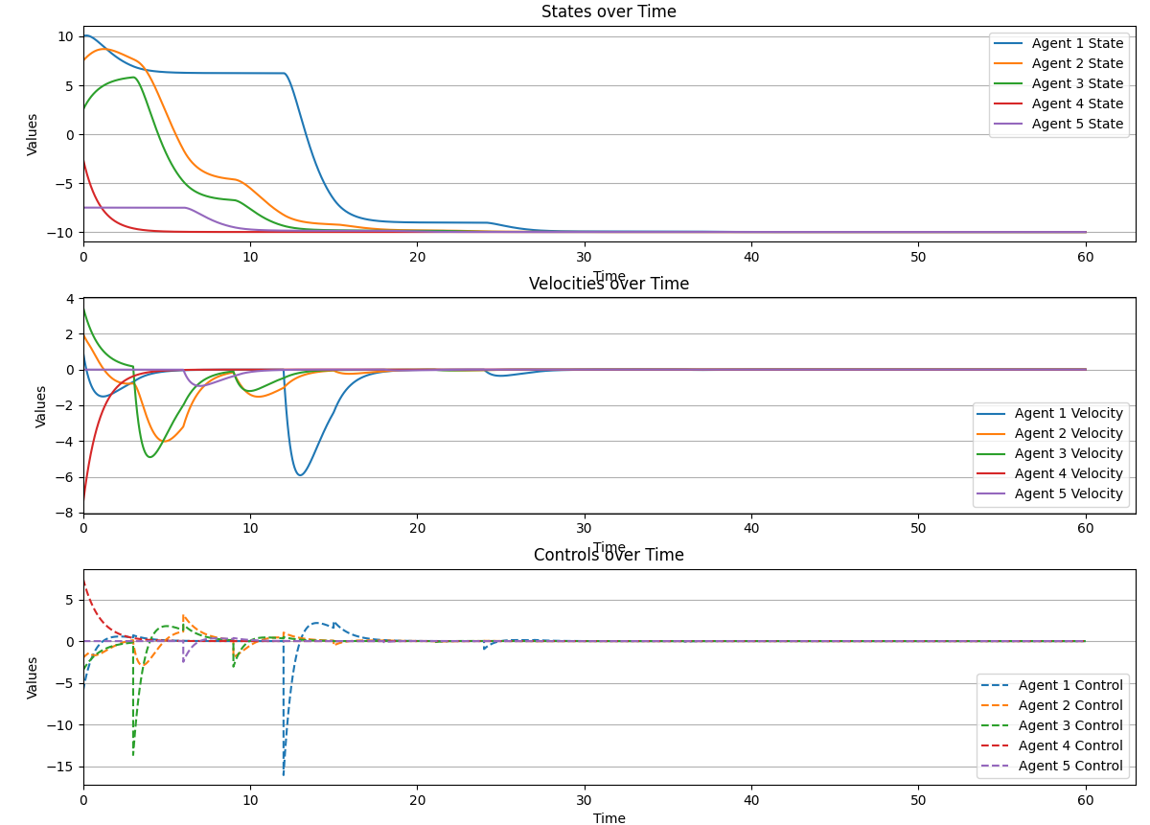
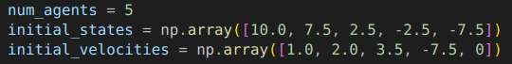

Slide 23
Literature review
Yinyan Zhang, Shuai Li, Second-order min-consensus on switching topology, Automatica, Volume 96, 2018, Pages 293-297, ISSN 0005-1098, https://doi.org/10.1016/j.automatica.2018.07.009
F. Bullo, Lectures on Network Systems, ed. 1.6, Kindle Direct Publishing, 2022, ISBN 978- 1986425643
https://ti.inf.ethz.ch/ew/courses/CG13/lecture/Chapter%203.pdf
https://web.stanford.edu/class/ee364b/lectures/subgradients_notes.pdf
http://www.seas.ucla.edu/~vandenbe/236C/lectures/subgradients.pdf

Slide 24
Thank You!

